Slide 1
Machine Learning Concepts Overview

Slide 2
Overview
What is Machine Learning?
Why Learn?
Supervised Learning: Key Concepts
Types of Supervised Learning, Loss functions
Overfitting, underfitting, Bias-Variance Trade-off
Supervised Learning: Popular Methods
Linear models
Decision Trees and Random Forests
K-NN Prediction
Neural networks
Bayesian learning
Unsupervised Learning
K-means clustering

Slide 3
Overview
What is Machine Learning?
Why Learn?
Supervised Learning: Key Concepts
Supervised Learning: Popular Methods
Unsupervised Learning

Slide 4
What is Machine Learning?
Methods and Systems that …
Predict new data based on observed data
Optimize an action given a cost function and observed data
Extract hidden structure from the data
Summarize data into concise descriptions
Adapt based on observed data

Slide 5
Overview
What is Machine Learning?
Why Learn?
Supervised Learning: Key Concepts
Supervised Learning: Popular Methods
Unsupervised learning

Slide 6
Why Learn?
Learn it when you can’t code it
Complex tasks where deterministic solution don’t suffice
e.g. speech recognition, handwriting recognition
Learn it when you can’t scale it
Repetitive task needing human-like expertise (e.g. recommendations, spam & fraud detection)
Speed, scale of data, number of data points
Learn it when you need to adapt/personalize
e.g., personalized product recommendations, stock predictions
Learn it when you can’t track it
e.g., automated driving, fraud detection (input-solution mapping changes dynamically)

Slide 7
Overview
What is Machine Learning?
Why Learn?
Supervised Learning: Key Concepts
Supervised Learning: Popular Methods
Unsupervised learning

Slide 8

Supervised Learning
Training: Given training examples {(X_{i}, Y_{i})} where X_{i} is the feature vector and Y_{i} the target variable, learn a function F to best fit the training data (i.e., Y_{i} ≈ F(X_{i}) for all i)
Prediction: Given a new sample X with unknown Y, predict Y using F(X)
Historical Data
(X₁, Y₁)
(X₂, Y₂₎
….
(X_{n},Y_{n})
Learning
Algorithm
Model
F
X
Y
URL
Title/Body Text
Model F
E-commerce Site ?
Hyperlinks
Features/Attributes
Target/Label

Slide 9
Types of Supervised Learning
Classification: Y is categorical
Examples:
Web page classification as e-Commerce/non e-Commerce (Binary)
Product classification into categories (Multi-class)
Model F: Logistic Regression, Decision Trees, Random Forests, Support Vector Machines, Naïve Bayes, etc.
Regression: Y is numeric (ordinal/real-valued)
Examples:
Base price markup prediction for a product
Forecasting demand for a product
Model F: Linear Regression, Regression Trees, Kernel Regression, etc.

Slide 10
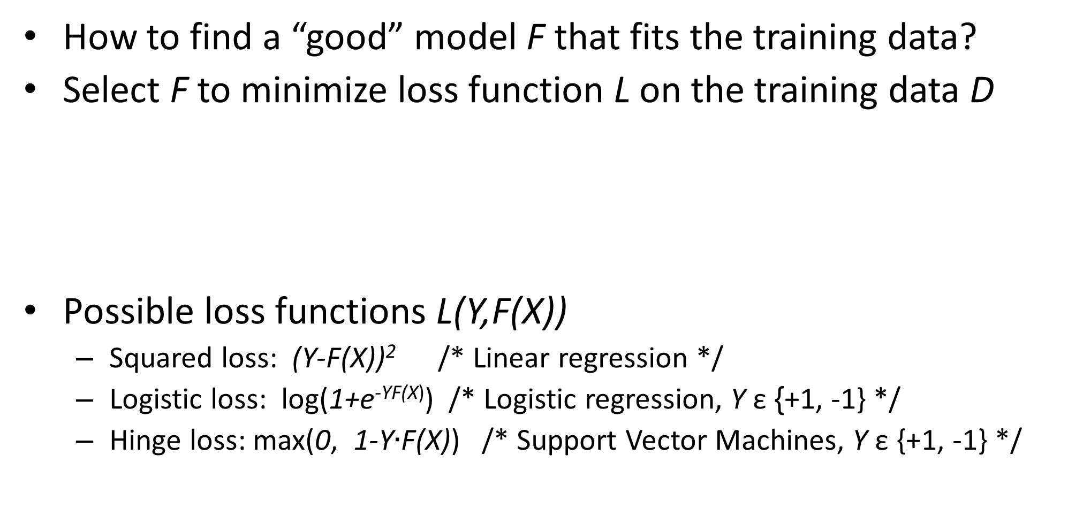
Loss Functions
How to find a “good” model F that fits the training data?
Select F to minimize loss function L on the training data D
Possible loss functions L(Y,F(X))
Squared loss: (Y-F(X))² /* Linear regression */
Logistic loss: log(1+e^{-YF(X)}) /* Logistic regression, Y ε {+1, -1} */
Hinge loss: max(0, 1-Y$∙$F(X)) /* Support Vector Machines, Y ε {+1, -1} */

Slide 11
Overfitting
Overfitting problem: Model fits training data well (low training error) but does not generalize well to unseen data (poor test error)
Complex models with large #parameters capture not only good patterns (that generalize) but also noisy ones
Y
High prediction error
X

Slide 12
Underfitting
Underfitting problem: Model lacks the expressive power to capture target distribution (poor training and test error)
Simple linear model cannot capture target distribution
Y
X

Slide 13
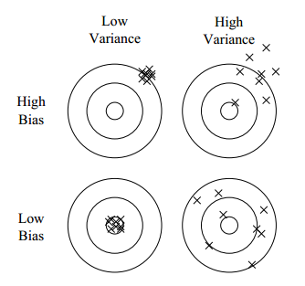
Bias-Variance Tradeoff
Bias: Difference between average model prediction and true target value
Variance: Variation in predictions across different training data samples
(Overfitting)
(Underfitting)

Slide 14
Bias-Variance Tradeoff
Simple models with small #parameters have high bias and low variance
E.g. Linear models with few features
Reduce bias by increasing model complexity (adding more features, decreasing regularization)
Complex models with large #parameters have low bias and high variance
E.g. Linear models with many sparse features, decision trees
Reduce variance by increasing training data and decreasing model complexity (feature selection, aggressive regularization)

Slide 15
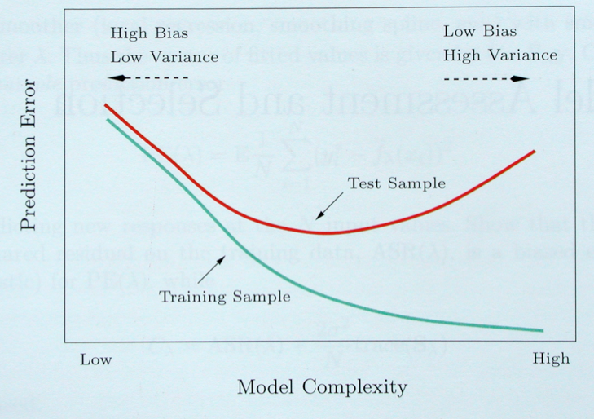
Bias-Variance Trade-off
Overfitting Region

Slide 16
Overview
What is Machine Learning?
Why Learn?
Supervised Learning: Key Concepts
Supervised Learning: Popular Methods
Unsupervised learning

Slide 17
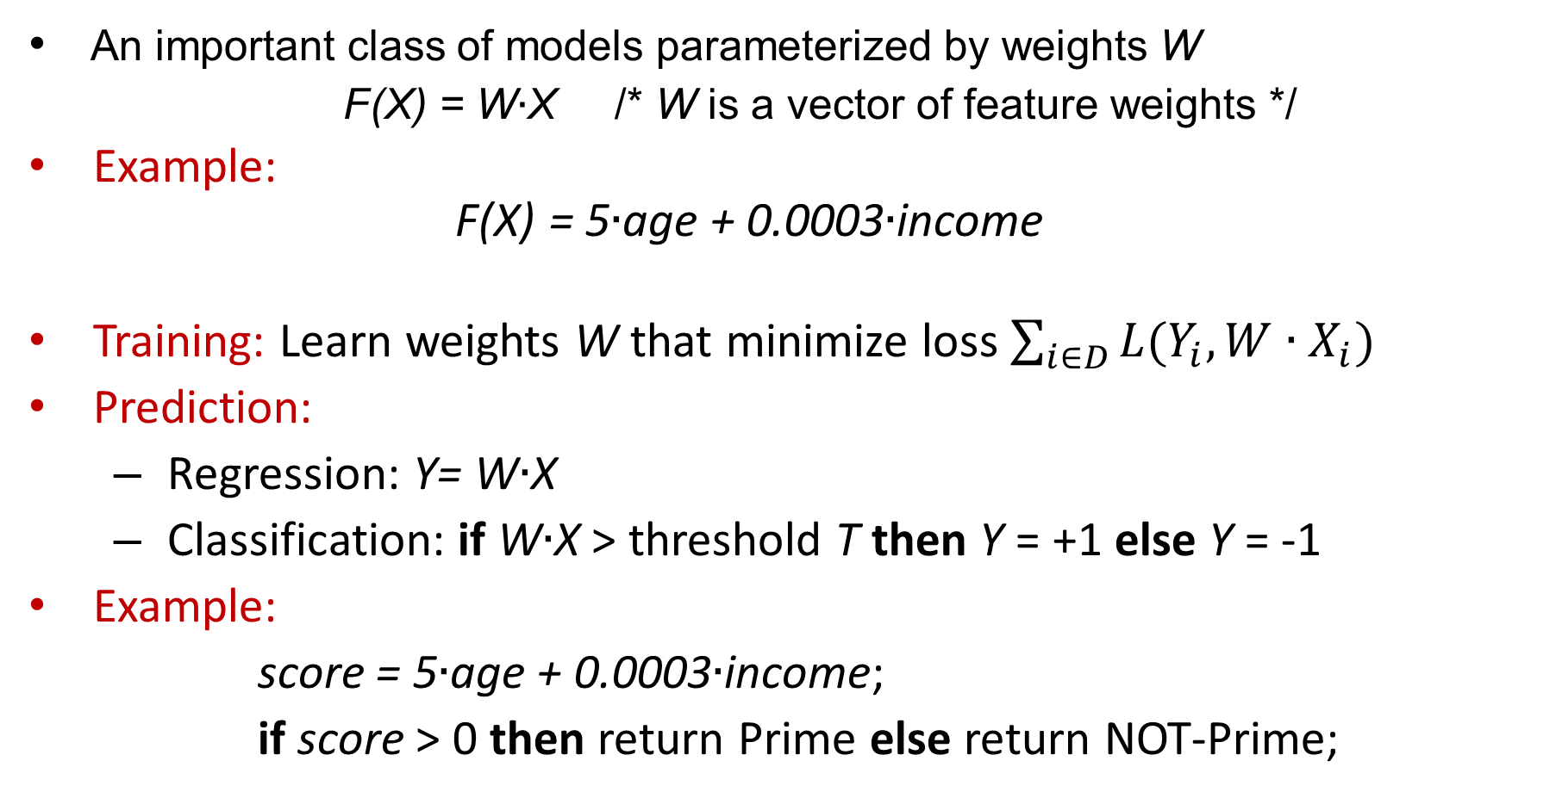
Linear Models
An important class of models parameterized by weights W
F(X) = W$∙$X /* W is a vector of feature weights */
Example: F(X) = 5$∙$age + 0.0003$∙$income
Training: Learn weights W that minimize loss $\sum_{i∈D}{L(Y_{i},W∙X_{i})}$
Prediction:
Regression: Y= W$∙$X
Classification: if W$∙$X > threshold T then Y = +1 else Y = -1
Example:
score = 5$∙$age + 0.0003$∙$income;
if score > 0 then return Prime else return NOT-Prime;

Slide 18
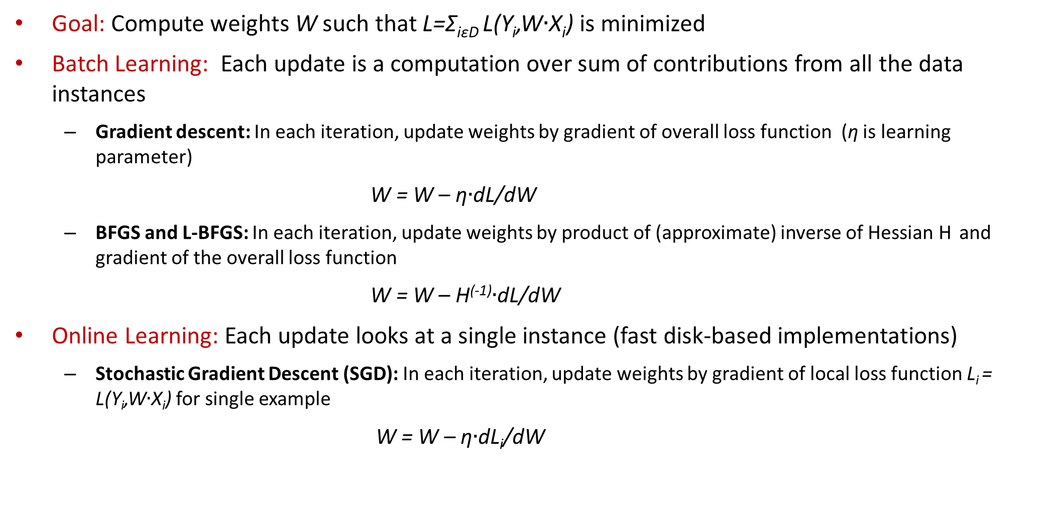
Linear Models: Learning Algorithms
Goal: Compute weights W such that L=Σ_{iεD} L(Y_{i},W$∙$X_{i}) is minimized
Batch Learning: Each update is a computation over sum of contributions from all the data instances
Gradient descent: In each iteration, update weights by gradient of overall loss function (η is learning parameter)
W = W – η$∙$dL/dW
BFGS and L-BFGS: In each iteration, update weights by product of (approximate) inverse of Hessian H and gradient of the overall loss function
W = W – H⁽⁻¹⁾$∙$dL/dW
Online Learning: Each update looks at a single instance (fast disk-based implementations)
Stochastic Gradient Descent (SGD): In each iteration, update weights by gradient of local loss function L_{i} = L(Y_{i},W$∙$X_{i}) for single example
W = W – η$∙$dL_{i}/dW

Slide 19
Linear Models: Regularization
Regularization prevents overfitting in linear models by penalizing large weight values
L₁ regularization: Add a term to loss function L
Aggressively reduces number of non-zero weights
L₂ regularization: Add a term to loss function L
Less aggressive in forcing weight values to zero

Slide 20
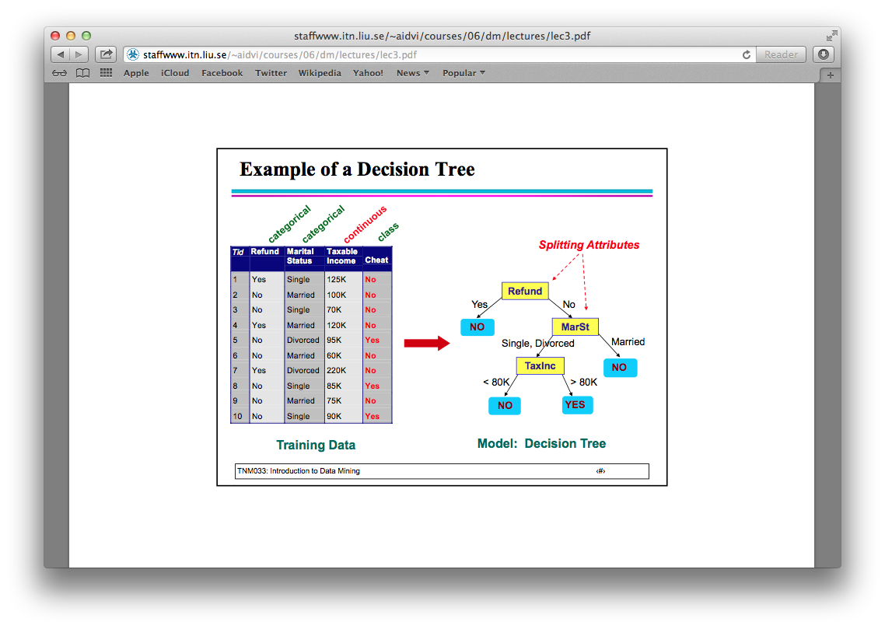
Decision Trees
Classification Trees: Leaf nodes associated with class label
Regression Trees: Leaf nodes associated with numeric values

Slide 21
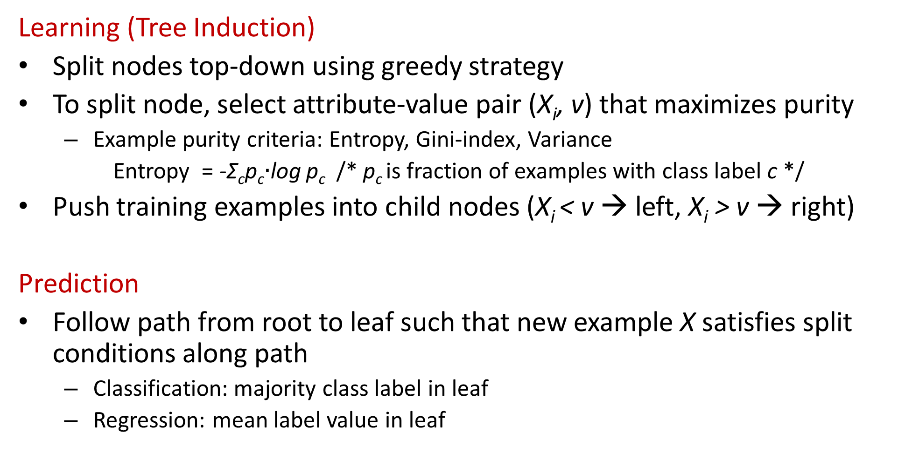
Decision Trees: Learning & Prediction
Learning (Tree Induction)
Split nodes top-down using greedy strategy
To split node, select attribute-value pair (X_{i}, v) that maximizes purity
Example purity criteria: Entropy, Gini-index, Variance
Entropy = -Σ_{c}p_{c}$∙$log p_{c} /* p_{c} is fraction of examples with class label c */
Push training examples into child nodes (X_{i} < v → left, X_{i} > v → right)
Prediction
Follow path from root to leaf such that new example X satisfies split conditions along path
Classification: majority class label in leaf
Regression: mean label value in leaf

Slide 22
Decision Trees: Pros & Cons
Extremely fast at classifying new instances
Easy to interpret for small-sized trees
Can capture complex non-linear behavior using conjunctions over attributes (Feature engineering effort is minimal)
Decision boundaries are rectilinear
High variance, i.e., small variations in the data can generate very different trees
Very susceptible to overfitting, i.e., large trees learn patterns in noise → training error keeps going down, but test error goes up
Problems can be fixed by using “Ensembles of Trees” !

Slide 23
Random Forest
Ensemble of Decision Trees
Training Data D
Bootstrap samples (induces diversity)
Subsample D₁
Subsample D₂
Subsample D₃
Construct decision trees considering a random
subset of attributes for
each node split
(reduces correlation)
Prediction: Combine predictions of trees in ensemble through majority voting (for classification) or averaging (for regression) (reduces variance)
ENSEMBLE
F(X)

Slide 24
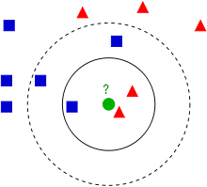
K-Nearest Neighbor (K-NN) Methods
Key idea: Predict label for a new instance X based on target values Y of K nearest neighbors of X
Classification: majority class label
Regression: mean of target values
Neighbors are determined based on an
appropriate distance metric, e.g., Euclidean distance
Pros: Learning is very simple, can learn complex target functions
Cons: Need to store every training example; prediction is slow; predictions often sensitive to choice of K

Slide 25
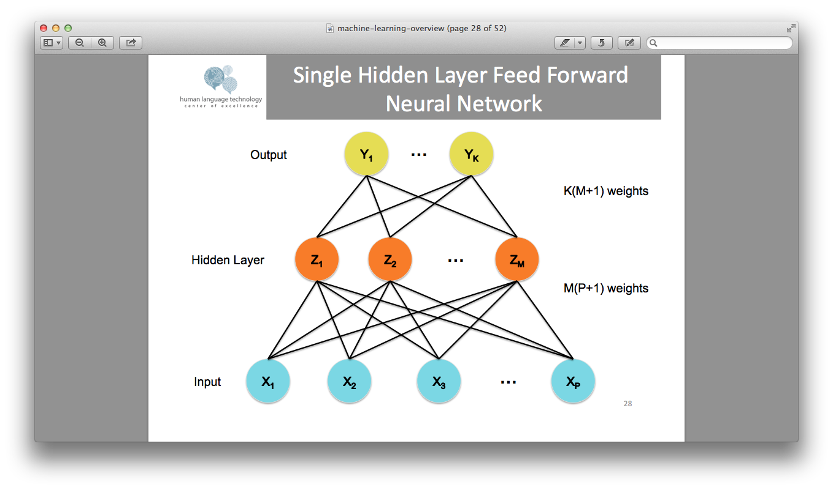
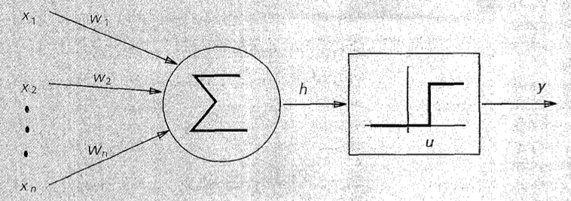
Neural Networks
Key idea: Multiple layers including hidden ones to capture complex non-linear dependencies between input variables X and target Y
Each hidden node is a linear model with a
non-linear activation function (e.g., sigmoid)
Pros: Can learn non-linear functions
Cons: Not easily interpretable, complex multi-layer learning algorithms (e.g. back-propagation), slow to converge
z

Slide 26
Naïve Bayes Classifier
Key idea: Assume a probabilistic generative model for (X, Y), estimate the joint model parameters & infer target class probabilities p(Y|X)
Each instance X_{i} comprises multiple features [X_{i1},… X_{im}]
Generative Model: Features X_{ij}’s are conditionally independent given target class Y_{i}
Class probabilities can be estimated via Bayes rule and used to find most likely label
Learning: Compute class conditional probabilities p(X_{ij}|Y_{i}) from training data
Pros: Learning is straightforward
Cons: Class- conditional independence does not always hold, smoothing is required for sparse features
Notes:
fraction of training examples belonging to class Y that contain feature value X^i

Slide 27
Overview
What is Machine Learning?
Why Learn?
Supervised Learning: Key Concepts
Supervised Learning: Popular Methods
Unsupervised Learning

Slide 28
Unsupervised Learning
Learning Problem: Given a set of data instances {X_{i}} without a distinguished target variable, learn a model that captures the hidden structure/patterns in the data.
Examples:
Clustering
Matrix factorization (e.g., PCA, SVD)
Topic models (LDA,PLSA) and other probabilistic latent factor models
Association rule mining
Historical Data
X₁
X₂
….
X_{n}
Learning
Algorithm
Model
M

Slide 29
Clustering
Given data instances {X₁,…, X_{n}}, partition them into K disjoint groups or clusters (partitioning → “hard” clustering)
.
.
Instances within a cluster are “similar” and those in different clusters are not.
Enables discovery of “classes” in an unsupervised manner
Other variants: overlapping clusters, #clusters automatically chosen using other criteria
.
.
.
.
.
.
.
.
.
.
.
.
.
.
.
.
.
.
.
.
.
.
.
.
.
.
.
.
.
.

Slide 30
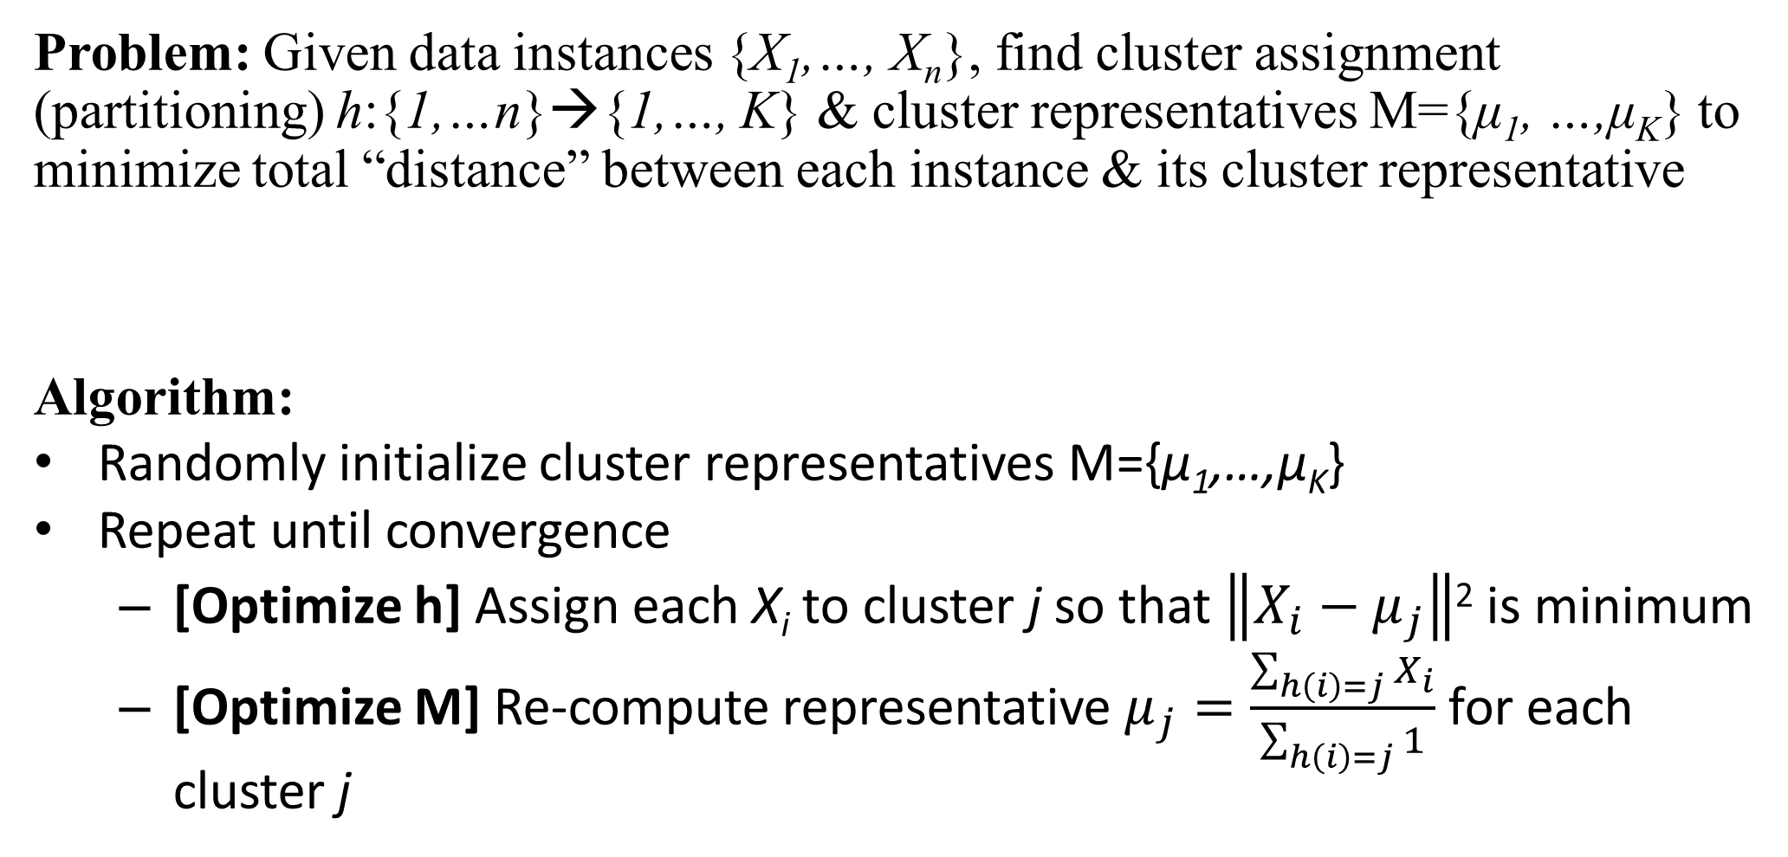
K-means Algorithm
Problem: Given data instances {X₁,…, X_{n}}, find cluster assignment (partitioning) h:{1,…n}→{1,…, K} & cluster representatives M={μ₁, …,μ_{K}} to minimize total “distance” between each instance & its cluster representative
Algorithm:
Randomly initialize cluster representatives M={μ₁,…,μ_{K}}
Repeat until convergence
[Optimize h] Assign each X_{i} to cluster j so that $\left\|X_{i}−μ_{j}\right\|$² is minimum
[Optimize M] Re-compute representative $μ_{j}=\frac{\sum_{h\left(i\right)=j}{X_{i}}}{\sum_{h\left(i\right)=j}{1}}$ for each cluster j

Slide 31
K-means Example (K=2)
Pick seeds
Reassign clusters
Compute centroids
Compute centroids
Reasssign clusters
x
Compute centroids
x
x
x
Reassign clusters
x
Converged!

Slide 32
Summary
What is Machine Learning?
Why Learn?
Supervised Learning: Key Concepts
Types of Supervised Learning, Loss functions
Overfitting, underfitting, Bias-Variance Trade-off
Supervised Learning: Popular Methods
Linear models
Decision Trees and Random Forests
K-NN Prediction
Neural networks
Bayesian learning
Unsupervised Learning
K-means clustering

